Slide 1
CYTOAUTOCLUSTER
- AKASH

Slide 2
Introduction
CytoAutoCluster is an innovative solution designed to enhance the analysis of high-dimensional cytometry data by clustering cells based on unique, identifiable characteristics.
Leveraging semi-supervised learning techniques, it integrates both labeled and unlabeled data to improve clustering accuracy and computational efficiency.

Slide 3
Techniques Used
The Levine_32dim dataset, sourced from Levine et al. (2015), comprises 265,627 cells characterized by 32 markers. Of these, 39% (104,184 cells) are manually labeled into 14 clusters, while the remaining 61% (161,443 cells) are unlabeled.
A correlation matrix in machine learning is used to visualize and identify the relationships between different features in a dataset, allowing data scientists to understand which variables are highly correlated with each other.
Skewness and kurtosis is a statistical measure that helps determine how asymmetric a distribution and it will help to find the outliers in the dataset

Slide 4
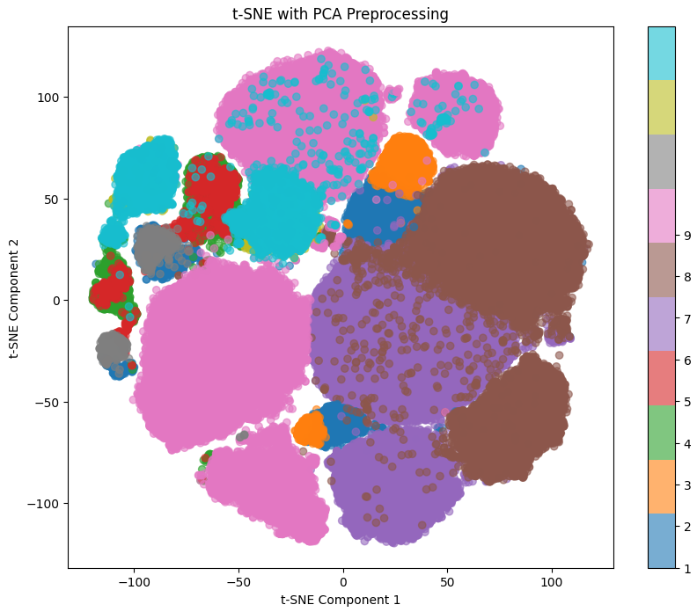
Dimensionality reduction
T-SNE and PCA :
These used primarily for dimensionality reduction, which means transforming complex, high-dimensional data into a lower-dimensional space, making it easier to visualize and analyze patterns within the data.
Clusters represent groups of data points that share similar characteristics or patterns. A well clustered output represents they are well-separated in the feature space with minimal overlap
Fig : T-SNE output before encoder model

Slide 5
Model Architecture and Implementation
Encoder model :
It is a Self-supervised learning approach used for dimensionality reduction and feature extraction. The encoder's output is then used as input to a separate classification model that is trained on the labeled data.
Semi-supervised model :
It is a strategy, which combines both labeled and unlabeled data to train a more accurate classification model.

Slide 6
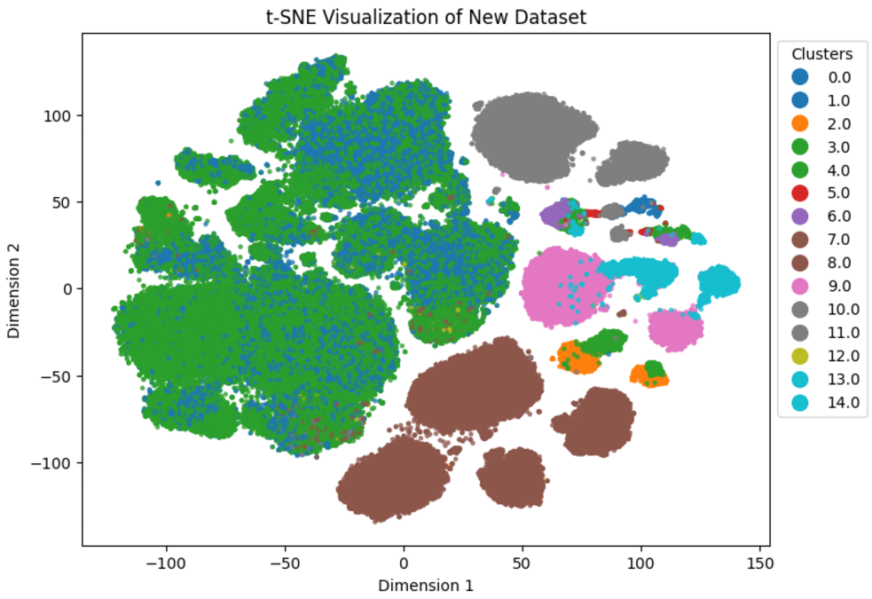
Results
Quantitative Metrics :
Logistic Regression Log Loss: 0.027
XGBoost Log Loss : 0.054
Self-Supervised Model Accuracy: 97.51%, AUROC: 99.16%
Fig : T-SNE Output after predicting the labels

Slide 7
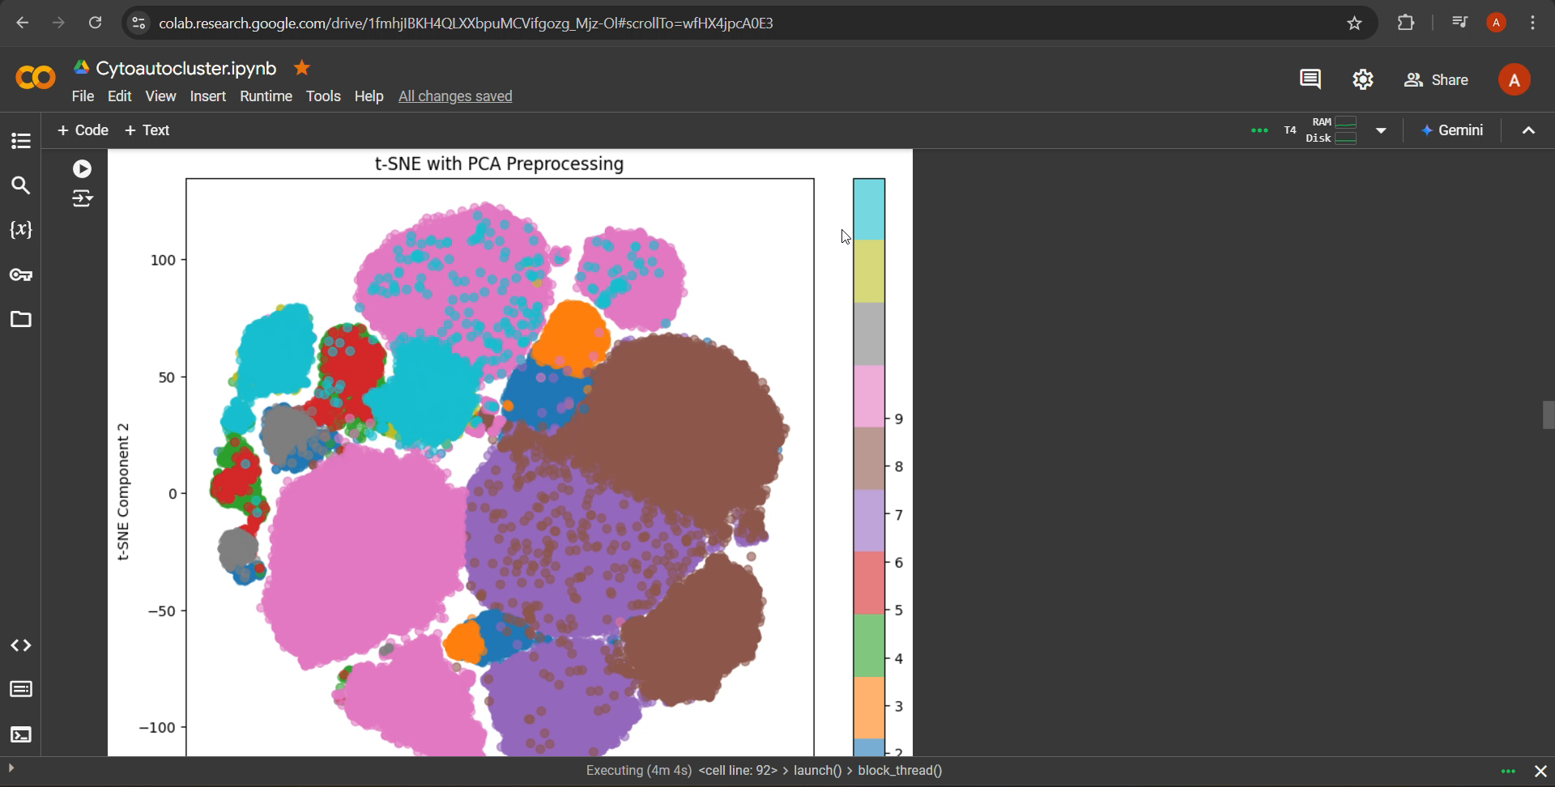
Gradio Implementation
To create an interactive user interface (UI) for your machine learning model
Displayes the tsne and the predicted labels of the inputed rows

Slide 8
THANKYOU

